Slide 1
Applied data science project 3 Predictive analytics-model evaluation and selection
Presented by Team 11
Guanzhong You; Yinxiang Gao;
Shuli Song; Cen Zeng; Yifei Hu
November 2nd, 2016

Slide 2
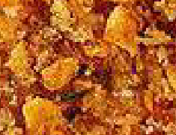
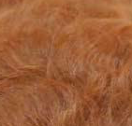
Motivation
Texture difference is useful in distinguishing dog and chickens
GLCM only uses 8 statistics in texture recognition, very light & can be very fast
Other algorithms:
May have higher accuracy, but
Most are better at shape recognition, but too redundant for texture recognition
Most rely on python and some unstable and reproducible unfriendly packages
So: Why not having fun and try something old in a new way?
(GLCM was developed at 1970s, but GBM at 2000s)

Slide 3
Process flow
DIVIDE | Divide the training image data into two parts: One for forming feature pool: pool_image; The other for supervised feature selection: learn_image.
RESIZE | Resize all large images to around 30000 pixels
CALCULATE STATISTICS | For each p*p window, calculate its statistics (glcm and color)
CLUSTER | Cluster the windows by their statistics, keep 100 cluster means for each image
GENERATE WORDS | Pool cluster means from all pool_image together and form a dictionary; each statistics (column) is scaled
WORD FREQUENCY | For each learn_image, calculate word frequency
FEATURE SELECTION | Find the most useful words in distinguishing chicken and dog (Random Forest)
MODEL TRAINING | Still use GBM

Slide 4
Get features
GLCM (Gray-Level Co-Occurrence Matrix):
The GLCM is a tabulation of how often different combinations of pixel brightness values (grey levels) occur in an image
"mean", "variance", "homogeneity", "contrast", "dissimilarity", "entropy", "second_moment", "correlation“
Color Pattern:
R, G, B (mean)
R, G, B (variance)
So for each window cluster: 8+6 features
Each window cluster mean is a “word”
All words in pool_image form a BIG dictionary

Slide 5
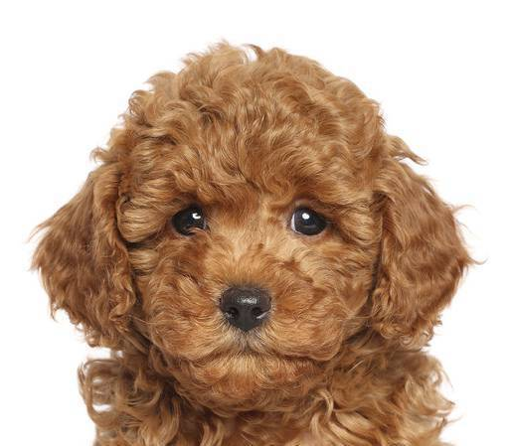
Get features

Slide 6
Get features

Slide 7
Get features
GLCM stats
Color stats
Win | S1 | S2 | … | S8 | … | S14
1 | 2 | 1 | 3 | 4 | 1 | 2
2 | 3 | 4 | 2 | 1 | 2 | 3
3 | 2 | 3 | 4 | 5 | 3 | 2
… | …
30000

Slide 8
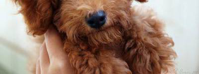
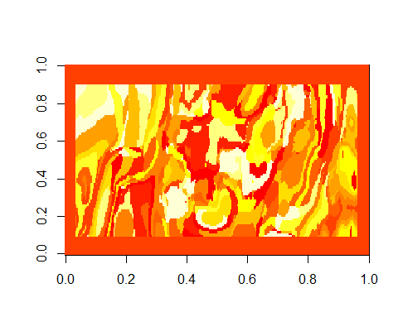
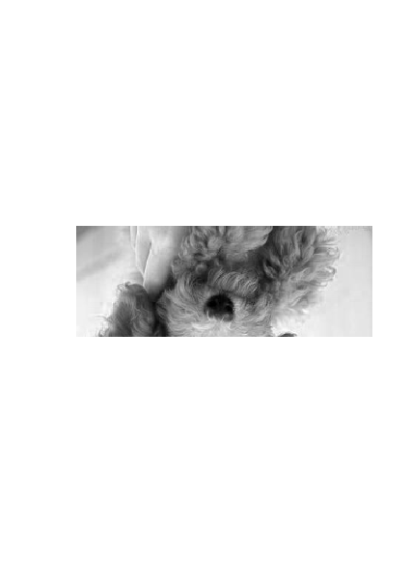
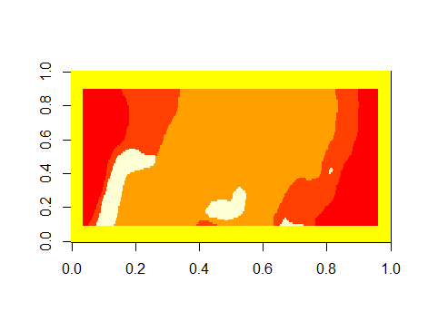
Cluster
Original
Cluster 100
Gray
Cluster 5

Slide 9
Cluster
GLCM stats
Color stats
Win | S1 | S2 | … | S8 | … | S14
1 | 2 | 1 | 3 | 4 | 1 | 2
2 | 3 | 4 | 2 | 1 | 2 | 3
3 | 2 | 3 | 4 | 5 | 3 | 2
… | …
30000
Cluster | S1 | S2 | … | S8 | … | S14
1 | 2 | 1 | 3 | 4 | 1 | 2
2 | 3 | 4 | 2 | 1 | 2 | 3
3 | 2 | 3 | 4 | 5 | 3 | 2
… | …
100

Slide 10
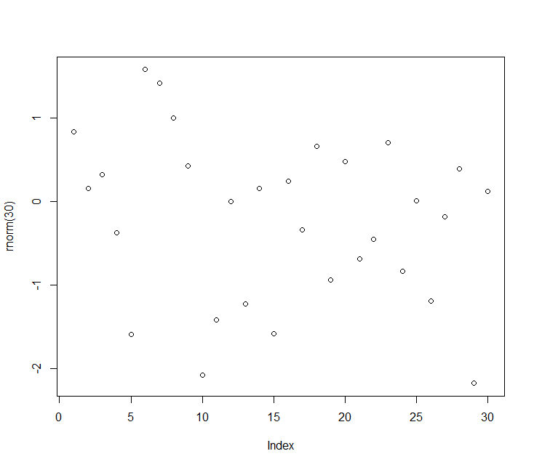
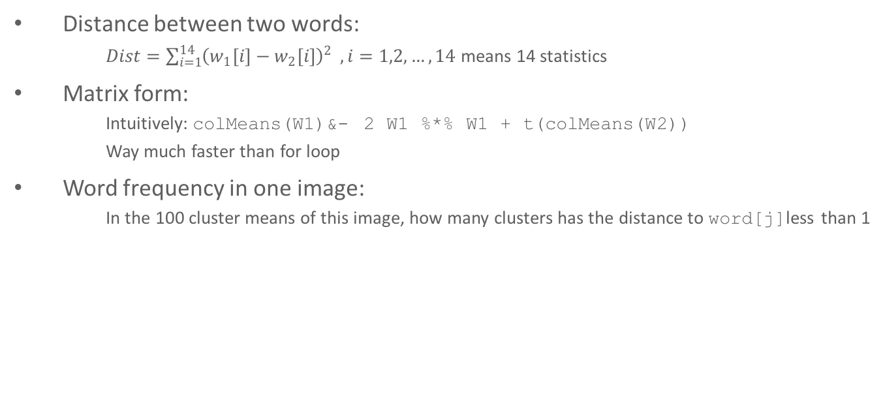
Word Frequency
Distance between two words:
$Dist=\sum_{i=1}^{14}{{\left(w_{1}\left[i\right]−w_{2}\left[i\right]\right)}^{2} }, i=1,2,…,14$ means 14 statistics
Matrix form:
Intuitively: colMeans(W1)&- 2 W1 %*% W1 + t(colMeans(W2))
Way much faster than for loop
Word frequency in one image:
In the 100 cluster means of this image, how many clusters has the distance to word[j]less than 1
BIG Dictionary
 | Word 1 | Word 2 | Word 3 | … | Word 10000
Word 1 | 1 | 6 | 0 | … | 7
Word 2 | 0 | 0 | 5 | … | 8
Word 3 | 4 | 0 | 0 | … | 0
….. | … | … | … | … | …
Word 100 | 0 | 0 | 8 | … | 2
3
Learn_
image[i]
4

Slide 11
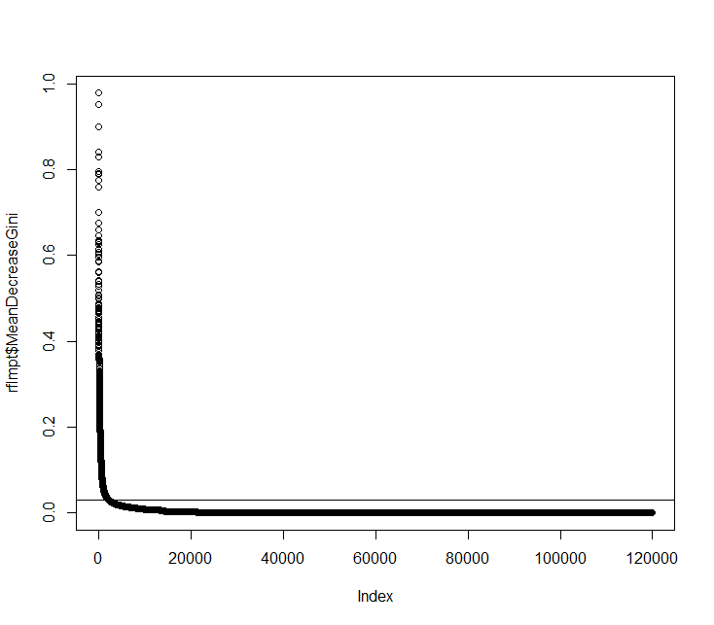
Feature Selection
Random Forest: Mean Gini Decreasing > 0.03
About 2.5 times the number of learn_image ( About 2k+ features for 1000 images)

Slide 12
Model training
GBM + SIFT (Baseline Model):
67% , Slow feature extraction
GBM + GLCM & COLOR (the Advanced Model):
80% + 3.5%, Simpler, Faster(Avg 0.6 s/pic), Reproducible, Stable
NNET + GLCM & COLOR :
80% + 3.5%, Nothing different but unstable
Other+ GLCM & COLOR :
80% + 3.5%, Nothing different, but longer time

Slide 13
In Brief
Change SIFT to GLCM+COLOR
Change key point selection in SIFT to CLUSTERING
Add RANDOM FOREST for feature selection
All others are the same
Accuracy: improve from 67% to around 80%

Slide 14
Titbits
Directly use color as feature: about 70% accuracy
R>2B; G>B; R>G
Filter out 500+ dog pictures (95% accurate)
Leave 1400+ pictures undetermined
Use the filtered pictures and then apply glcm+gbm: about 75%

Slide 15
Thank you
Presented by Team 11
Guanzhong You; Yinxiang Gao;
Shuli Song; Cen Zeng; Yifei Hu
November 2nd, 2016

